Slide 1

Compiler Design Project
Topic:-Sentiment Analysis Using RNN
1. Swraj Kant Sharma(2k19/co/402)

Slide 2

Introduction
(About The Project)
Sentiment Analysis:-
According to Google,the process of computationally identifying and categorizing opinions expressed in a piece of text, especially in order to determine whether the writer's attitude towards a particular topic, product, etc. is positive, negative, or neutral is termed as sentiment analysis.
In this project i have implemented Recurrent Neural Networks(RNN) using Long Short Term Memory(LSTM) to perform the sentiment analysis.

Slide 3

Introduction
(About the dataset)
In this project i have used the IMDB dataset.The IMDB dataset is a set of 50,000 highly polarized reviews from the Internet Movie Database. They are split into 25000 reviews each for training and testing. Each set contains an equal number (50%) of positive and negative reviews.
The IMDB dataset comes packaged with Keras. It consists of reviews and their corresponding labels (0 for negative and 1 for positive review).

Slide 4
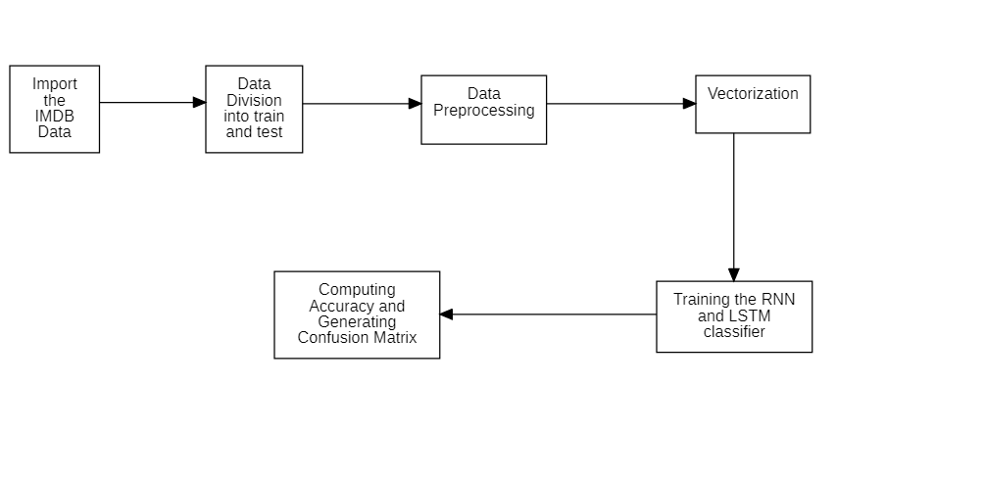
System Flowchart

Slide 5
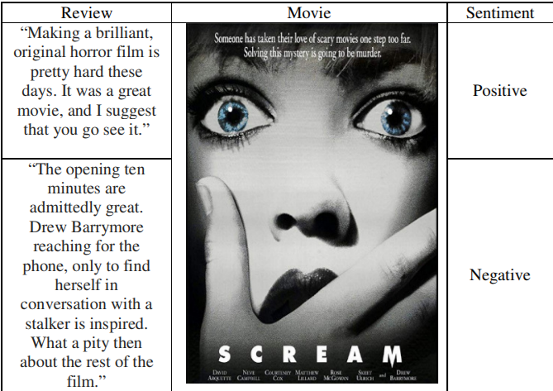
1.Loading the Dataset
Dataset is containing 50k movie reviews from IMDb. The data have already been splitted into 25k reviews for training purposes while the other 25k is intended for testing the classifier.
According to dataset creator anything ≤ 4 stars is labeled negative and ≥ 7 stars is marked as positive.
The dataset contains 88585 different words.

Slide 6
2.Data Division
Out of the 50k reviews i have done the 80-20 split which gives 80% to the training and 20% to the testing.
For the validation purpose 20% of the training data have been used to avoid the model from overfitting.

Slide 7
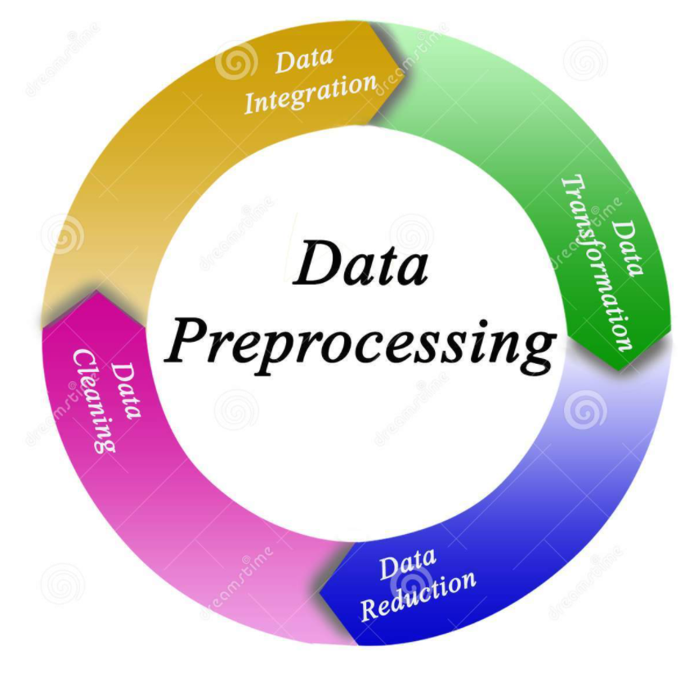
3.Data preprocessing
The dataset has already been preprocessed as a sequence of integers, where each integer stands for a specific word in the dictionary.
Download the dictionary that will tell that which integer corresponds to which word.
When vocab is created then after considering all the words three extra words gets added by default. a.PadWord b.Start c.Unknown Words. Therefore it will removed from the actual review.

Slide 8
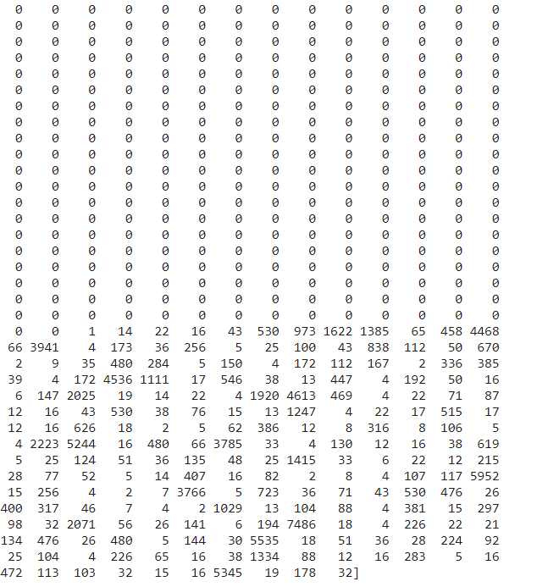
4. Creating The Embedding Layer
We cannot feed a list of integers into our deep neural network. We will need to convert them into 2-d tensors.
To prepare our data, we will One-hot Encode our lists and turn them into vectors of 0’s and specific key of that word. This would blow up all of our sequences into 500-dimensional vectors containing all non-zero indices corresponding to integers present in that sequence. This vector will have element 0 at all index, which is not present in the integer sequence.
Every index with value non-zero, is a word that is present in the review and is denoted by its integer counterpart.
Every index containing 0 is a word not present in the review.

Slide 9
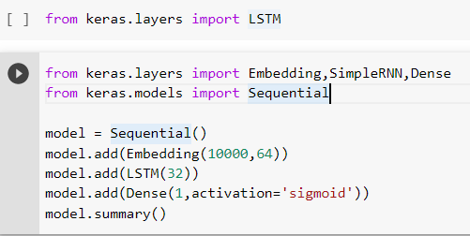
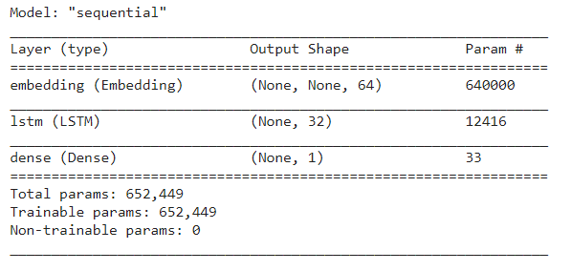
5.Model Architecture
Embedding accepts vocab size and output dimensions(k)
The output shape of embedding layer is going to be (25000*500*64)
Total parameters learned by embedding layer (vocab size* k)
Output activation dimension 32 (Context Vector Dimensions)
Here the activation is sigmoid as it is a binary classification problem

Slide 10
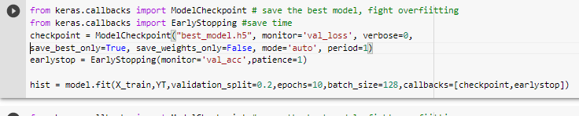
Model Training
Patience=k:-model will wait for k epochs and if validation accuracy does not inc. then the model will stop training.This is done to avoid overfitting.
best_model.h5:-Saves the model when the Validation Accuracy Increases and discard the model when the

Slide 11
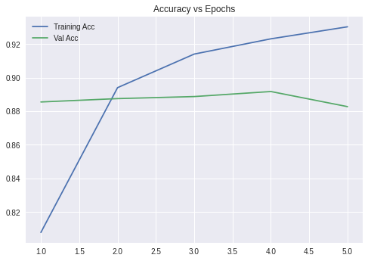
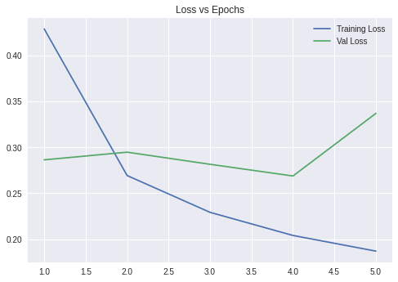
6.Result Visualization
From the two graph we can see that that the training and the validation accuracies are quite comparable and also the training loss and the validation loss have decreased sharply.Therefore we can say that the model has not overfitted.

Slide 12
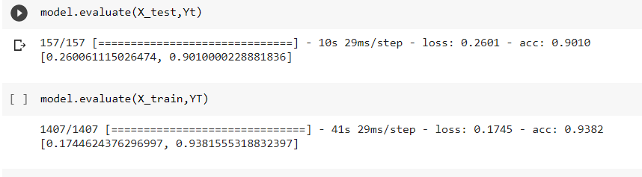
Train,Test Accuracy:-
After tuning a lot hyperparameters the highest test accuracy that i managed to achieve is around 90.1%. And the highest train accuracy is around 93.8%.

Slide 13
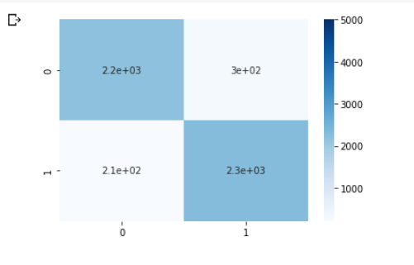
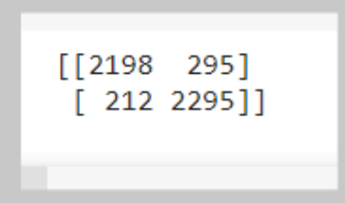
Confusion Matrix
Out of around 2500 negative reviews only 295 reviews have been misclassified and 2198 reviews are correctly classified. And similarly for the positive reviews only 212 have been misclassified and 2295 reviews have been correctly classified.

Slide 14
References:-
S. M. Qaisar, "Sentiment Analysis of IMDb Movie Reviews Using Long Short-Term Memory," 2020 2nd International Conference on Computer and Information Sciences (ICCIS), 2020, pp. 1-4, doi: 10.1109/ICCIS49240.2020.9257657.
R. Agarwal, D. Jain, G. Sharma and J. Tiwari, "Machine Learning based Click Bait Detection System," 2021 International Conference on Artificial Intelligence and Smart Systems (ICAIS), 2021, pp. 1714-1720, doi: 10.1109/ICAIS50930.2021.9395898.
D. Goularas and S. Kamis, "Evaluation of Deep Learning Techniques in Sentiment Analysis from Twitter Data," 2019 International Conference on Deep Learning and Machine Learning in Emerging Applications (Deep-ML), 2019, pp. 12-17, doi: 10.1109/Deep-ML.2019.00011.
B. Nath Saha and A. Senapati, "Long Short Term Memory (LSTM) based Deep Learning for Sentiment Analysis of English and Spanish Data," 2020 International Conference on Computational Performance Evaluation (ComPE), 2020, pp. 442-446, doi: 10.1109/ComPE49325.2020.9200054.

